Slide 1


Design and Analysis of Data Structures and Algorithms
Presentation by
Lyernisha S R

Slide 2
Algorithm and problem solving-2

Slide 3

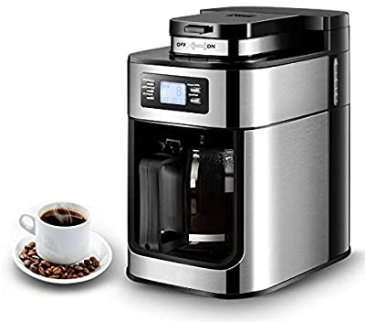
Algorithms and problem-solving
Design a robot domestic servant that can make a cup of instant coffee
Specify this process in not more than 4 high-level steps

Slide 4
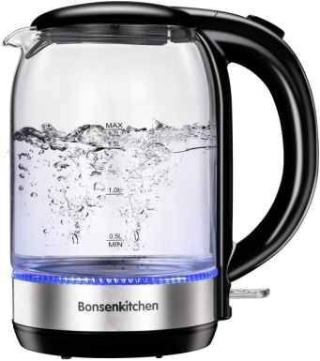
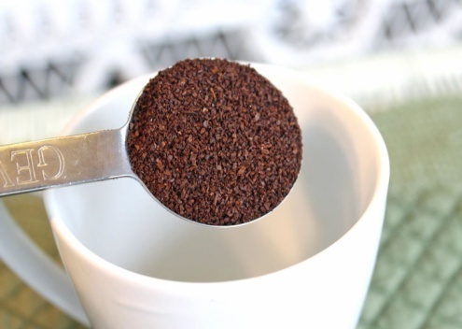
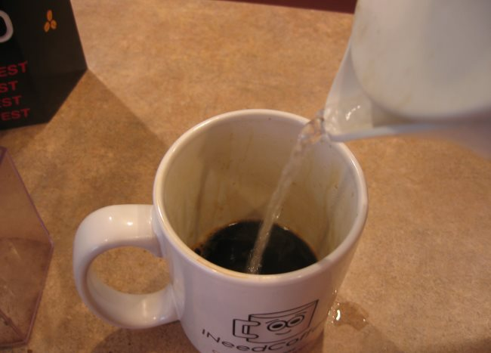
Example
High level specification/algorithm:
Boil water
Put coffee and sugar in cup
Add water to cup

Slide 5
Example (Contd..)
Refine high-level step 1 into not more than 4 sub-processes
1.Step BOIL WATER can be further refined into:
1.1 Fill kettle
1.2 Switch on kettle
1.3 Wait until boiling
1.4 Switch off kettle
2.Step PUT COFFEE IN CUP can be further refined into:
2.1 Open coffee jar
2.2 Extract one spoonful of coffee
2.3 Tip spoonful into cup
2.4 Close coffee jar

Slide 6


Example (Contd..)
3.Step ADD WATER TO CUP can be further refined into:
3.1 Pour water into cup
3.2 Stop when it is full
But these steps may also be insufficiently specified.
4.Step FILL KETTLE can be further refined into:
4.1 Put kettle under tap
4.2 Turn on tap
4.3 Wait until kettle is full
4.4 Turn off tap
This process of decomposition and refinement can continue until the level of specification is complete to enable the algorithm (or robot) to complete a fully process.

Slide 7
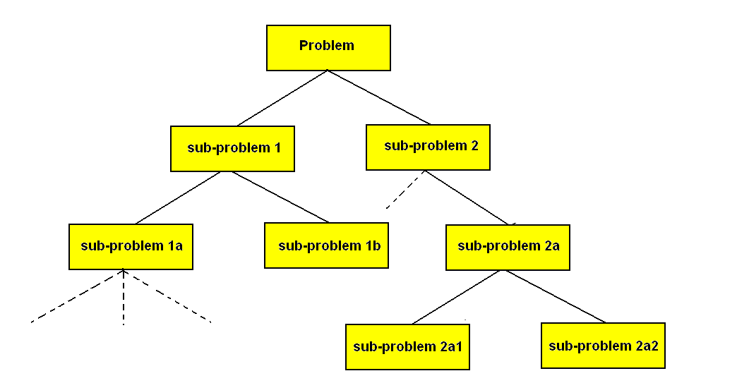
Top-down design
TDD offers the problem-solver a powerful means to deal with problem complexity.
Otherwise known as step-wise refinement or functional decomposition
Used at all levels of program and system design and specification
Solutions to problems developed in a step-wise fashion

Slide 8
Problem decomposition
Start from general problem statements
Repeatedly segment each analysis into smaller problem units
These correspond to problem sub-tasks
The number of levels of this process depends on the complexity of the problem
As this process proceeds the problem specification gets closer to implementation

Slide 9
Data structures: some preliminary comments.
Appropriate selection of data structures is essential
The way data is represented has a significant affect on program design and performance
When can decisions on data structures be made?
The problem domain will aid our determination of this.
However, data structures and algorithms are often linked in ways that make their choice obvious
There is a direct link between algorithms and data; how the latter is represented impacts on processing.

Slide 10
Issues to consider when choosing data structures
Can the data structure be easily searched?
Can the data structure be easily updated?
Does the data structure provide a way of recovering an earlier state in the computation?
Can the problem be formulated in terms of one of the common data structures such as arrays, sets, queues, stacks, trees, graphs, and lists?

Slide 11
Verification: some preliminary questions.
Programming is complex and time-intensive.
Much time expended(spent) checking programs.
Difficult to verify that a program works in all cases.
So rigorous mathematical techniques can be applied to help guarantee a program’s validity

Slide 12
Verification: some preliminary questions.
We need to ask ourselves:
What happens in a program given certain input?
What is the execution path taken? A variety of paths may be possible to attain successful termination.
But for a given set of input conditions, only ONE path can be taken.
This process can be characterized as a sequence of transitions from one computation state to another, wherein a STATE is defined in terms of the values held by program variables at a given time point.
A state transition occurs when the value of a variable changes and control transferred to the next instruction on the current execution path.

Slide 13
Verification: some preliminary questions.
All this provides the basis for establishing a foundation on which to construct:
CORRECTNESS PROOFS for algorithms
This leads us to the analysis of algorithms to determine their
Correctness
Efficiency
using a variety of methods.

Slide 14
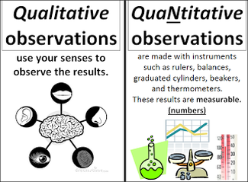
Analysis of algorithms
What is a ‘good’ algorithm?
Does the proposed algorithm work?
How do we determine this?
Does it work in ALL cases?
Correctness proofs
Verification
Input and output assertions
Goodness can be measured and/or quantified in both:
Qualitative
Quantitative

Slide 15
Qualitative measures
1. Simple but powerful solutions
2. Can be easily understood by others
3. They are easily modifiable
4. They are computationally correct for a clearly defined set of contexts
5. Can be understood at different levels of abstraction
6. Computationally economical in terms of space and time resources
7. Well documented
8. They should not be machine-dependent
9. They can be used as sub-procedures for other programs
10. They exhibit elegance in design

Slide 16
Quantitative measures
Enable us to predict a program’s:
behaviour
from different operational perspectives and to:
compare
different algorithms working on the same problem.

Slide 17
Fundamental algorithms
Programs are written using only a very basic and small collection of instructions or programming constructs.
Only a limited number of programming constructs are used to perform all computations
Fundamentally:
Instructions for storing information
Instructions for mathematical calculations
Instructions for comparing information
Instructions for controlling how computations are performed
All these constructs feature in high level programming languages
They are then combined to form larger, complex computational constructs – programs, sub-programs, sub-routines, and so on.

Slide 18
Fundamental algorithms
1. Exchanging the values of two variables – given two variables a and b, exchange the values assigned to them
2. Counting – given a set of n students’ examination marks (in the range 0 to 100) make a count of the number of students that passed the examination, where the pass mark is 50.
3. Summation of a set of numbers – given a set of n numbers, design an algorithm that adds these numbers and returns the resultant sum (assume n is > or = 0).

Slide 19
Exchanging values:
This is a fundamental process that recurs in many different searching and sorting algorithms.
Counting values:
Counting is central to almost all algorithms.
Generally, a count is made of some value that is part of a set of values or satisfies some condition.
For example, given a set of n students’ examination marks (in the range 0 to 100) make a count of the number of students that passed the exam. A pass is awarded for all students with a mark of 50 and above
Summation:
Once again, a fundamental operation in many algorithms.
Frequently there is a need to add a collection of numbers together.

Slide 20
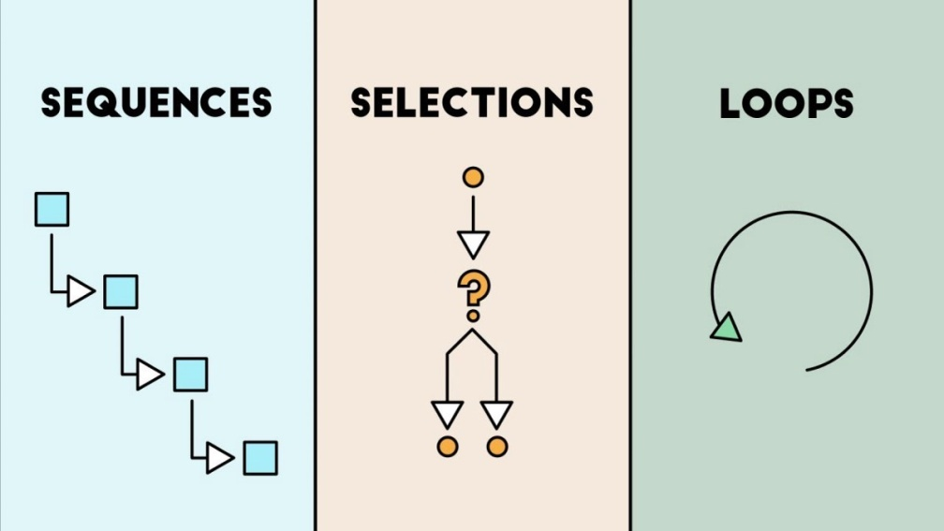
Fundamental algorithmic constructs
Most algorithmic processes can be described in the following ways, as either:
Sequence
Selection
Iteration
These three forms are sufficient for constructing any algorithm

Slide 21
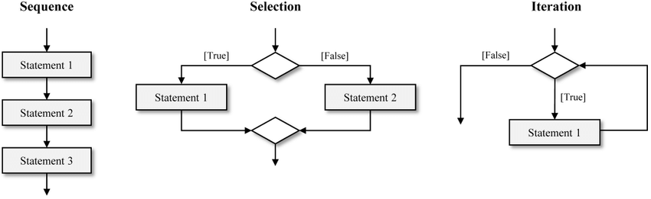
1. Sequence
A list of statements: do this, then this then this; one
instruction after another
Coffee-making algorithm:
1. Boil water
2. Put coffee in cup
3. Add water to cup
Comprises a simple SEQUENCE of steps:
Each step executed one at a time
Each step is executed once only and none are omitted
The order of the steps is always the same
Execution of last step is equivalent to terminating the algorithm
Such a structure is highly inflexible and cannot respond to changes in the environment.

Slide 22
2. Selection
Enables more flexible behavior as the algorithm’s actions can be determined by a range of conditions, not just one.
If the robot opens the coffee jar and finds it empty what does it do?
It needs to execute an alternative step:
Get new jar from cupboard
So we expand or enhance step 2 Open coffee jar thus:
Take coffee jar off shelf
if jar is empty
then get new jar from cupboard
Remove lid from jar
Important change here is the inclusion of the if then clause which enables the SELECTION of different courses of action depending on conditions being true or false.

Slide 23
Selection (Contd…)
If condition then action else a different action
To arbitrary levels of complexity:
If x > y
then if x > z
then choose x
else choose z
else if y > z
then choose y
else choose z
x=2, y= 6, z=10

Slide 24
3. Iteration
Keep repeating something until a condition is met
For example, a very simple algorithm for eating breakfast cereal might consist of these steps:
put cereal in bowl
add milk to cereal
spoon cereal and milk into mouth
repeat step 3 until all cereal and milk is eaten
rinse bowl and spoon

Slide 25
Iteration (Contd..)
What are the problems with this program?
When do we stop? How many if then clauses should we write?
Other constructs need to be used for algorithms whose length is variable, depending on circumstances.
Several looping constructs available to do this:
Repeat until
For.. Do..
While… do…

Slide 26
Merging, Sorting, and Searching
Merging and sorting:
These are means to:
ORGANISE data
to facilitate the efficient:
RETRIEVAL of data.
So they:
STRUCTURE the data
Searching methods exploit such organizations reducing retrieval time.
We sort to aid searching – that is why dictionaries, telephone books, etc, are sorted.

Slide 27
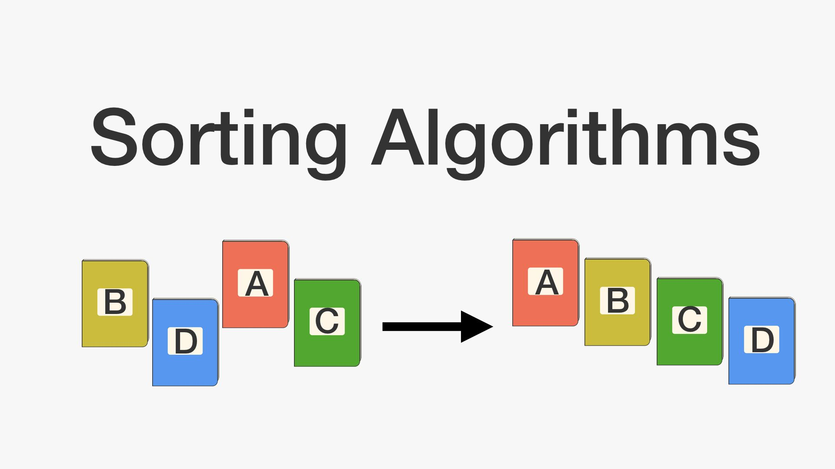
Sorting algorithms
Sorting algorithms:
Arrange items in a collection of data into a pre-defined order.
Numerical data is placed in ascending order (small to large), such as student records, alphabetic information, library records, etc.
In the case of records, a data item in the record has to be chosen as an identifier. This is called the KEY.
Sorting applied by:
Selection routines
Exchange routines
Insertion routines
Partitioning routines
No one sorting method is best – depends on application.
Performance depends on:
Size of data set
Degree the data set is already in order
Distribution of values
Amount of information associated with the data – simple or complex

Slide 28
Thank you!

